Slide 1
Graph

Slide 2
Definition
Graph is a non-linear data structure.
It contains a set of points known as nodes (or vertices) and a set of links known as edges (or Arcs).
Here edges are used to connect the vertices.
Definition: Graph is a collection of nodes and edges in which nodes are connected with edges

Slide 3
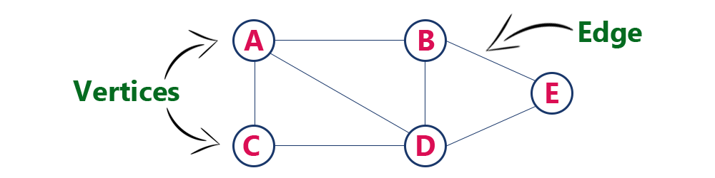
Example

Slide 4
Terminology
Vertex
Individual data element of a graph is called as Vertex. Vertex is also known as node. In above example graph, A, B, C, D & E are known as vertices.
Edge
An edge is a connecting link between two vertices. Edge is also known as Arc. An edge is represented as (startingVertex, endingVertex). For example, in above graph the link between vertices A and B is represented as (A,B). In above example graph, there are 7 edges (i.e., (A,B), (A,C), (A,D), (B,D), (B,E), (C,D), (D,E)).

Slide 5
Types of Edges
Edges are three types.
Undirected Edge - An undirected egde is a bidirectional edge. If there is undirected edge between vertices A and B then edge (A , B) is equal to edge (B , A).
Directed Edge - A directed egde is a unidirectional edge. If there is directed edge between vertices A and B then edge (A , B) is not equal to edge (B , A).
Weighted Edge - A weighted egde is a edge with value (cost) on it.

Slide 6
Terminology (Contd.)
Undirected Graph
A graph with only undirected edges is said to be undirected graph.
Directed Graph
A graph with only directed edges is said to be directed graph.
Mixed Graph
A graph with both undirected and directed edges is said to be mixed graph.

Slide 7
Terminology (Contd.)
Adjacent
If there is an edge between vertices A and B then both A and B are said to be adjacent. In other words, vertices A and B are said to be adjacent if there is an edge between them.
Incident
Edge is said to be incident on a vertex if the vertex is one of the endpoints of that edge.

Slide 8
Terminology (Contd.)
Degree
Total number of edges connected to a vertex is said to be degree of that vertex.
Indegree
Total number of incoming edges connected to a vertex is said to be indegree of that vertex.
Outdegree
Total number of outgoing edges connected to a vertex is said to be outdegree of that vertex.

Slide 9
Terminology (Contd.)
Parallel edges or Multiple edges
If there are two undirected edges with same end vertices and two directed edges with same origin and destination, such edges are called parallel edges or multiple edges.
Self-loop
Edge (undirected or directed) is a self-loop if its two endpoints coincide with each other.

Slide 10
Terminology (Contd.)
Simple Graph
A graph is said to be simple if there are no parallel and self-loop edges.
Path
A path is a sequence of alternate vertices and edges that starts at a vertex and ends at other vertex such that each edge is incident to its predecessor and successor vertex.

Slide 11
Graph Representation
Graph data structure is represented using following representations...
Adjacency Matrix
Adjacency List

Slide 12
Adjacency Matrix
In this representation, the graph is represented using a matrix of size total number of vertices by a total number of vertices.
That means a graph with 4 vertices is represented using a matrix of size 4X4.
In this matrix, both rows and columns represent vertices. This matrix is filled with either 1 or 0. Here, 1 represents that there is an edge from row vertex to column vertex and 0 represents that there is no edge from row vertex to column vertex.

Slide 13
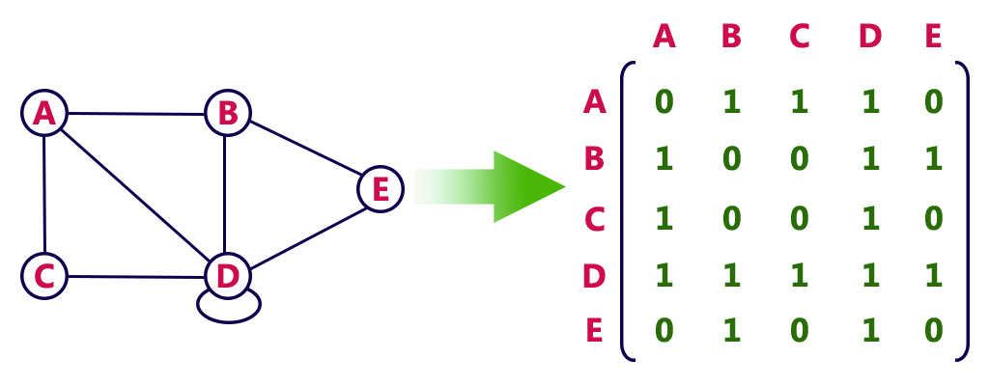
Example

Slide 14
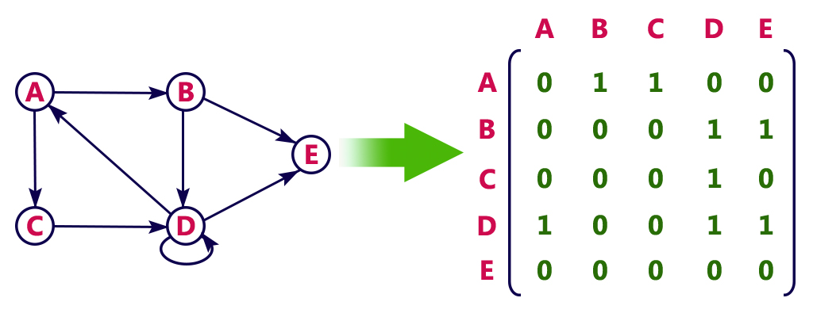
Example

Slide 15
Adjacency List
In this representation, every vertex of a graph contains list of its adjacent vertices.

Slide 16
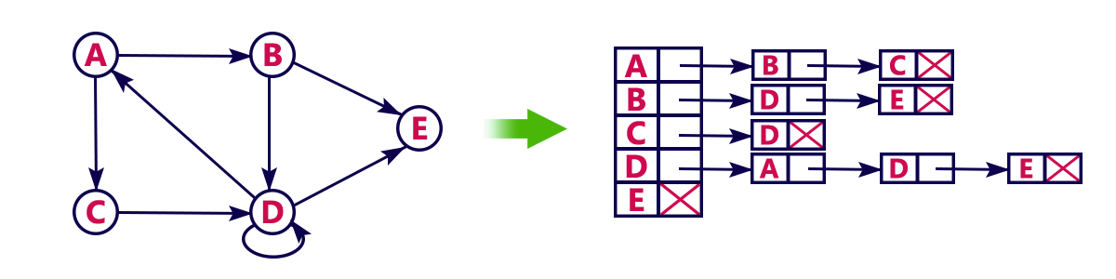
Example

Slide 17
Graph Traversal
Graph traversal is a technique used for a searching vertex in a graph.
The graph traversal is also used to decide the order of vertices is visited in the search process.
A graph traversal finds the edges to be used in the search process without creating loops.

Slide 18
Types
DFS (Depth First Search)
BFS (Breadth First Search)

Slide 19
DFS (Depth First Search)
DFS traversal of a graph produces a spanning tree as final result.
Spanning Tree is a graph without loops.
We use Stack data structure with maximum size of total number of vertices in the graph to implement DFS traversal.

Slide 20
Steps
Step 1 - Define a Stack of size total number of vertices in the graph.
Step 2 - Select any vertex as starting point for traversal. Visit that vertex and push it on to the Stack.
Step 3 - Visit any one of the non-visited adjacent vertices of a vertex which is at the top of stack and push it on to the stack.
Step 4 - Repeat step 3 until there is no new vertex to be visited from the vertex which is at the top of the stack.
Step 5 - When there is no new vertex to visit then use back tracking and pop one vertex from the stack.
Step 6 - Repeat steps 3, 4 and 5 until stack becomes Empty.
Step 7 - When stack becomes Empty, then produce final spanning tree by removing unused edges from the graph

Slide 21
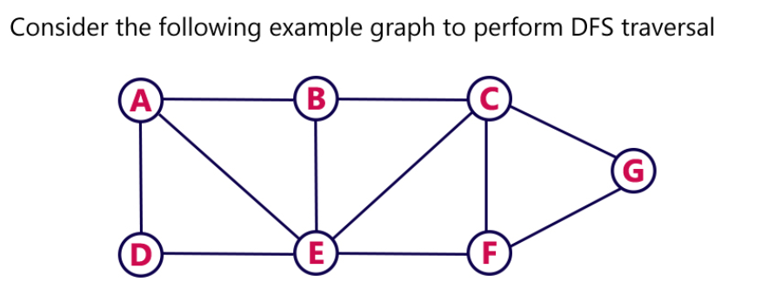
Example

Slide 22
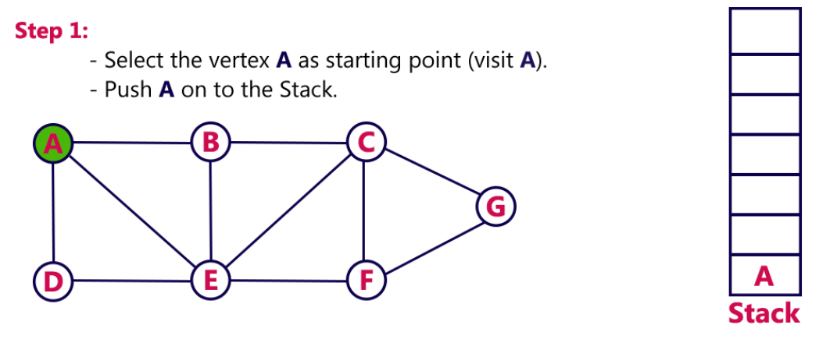

Slide 23
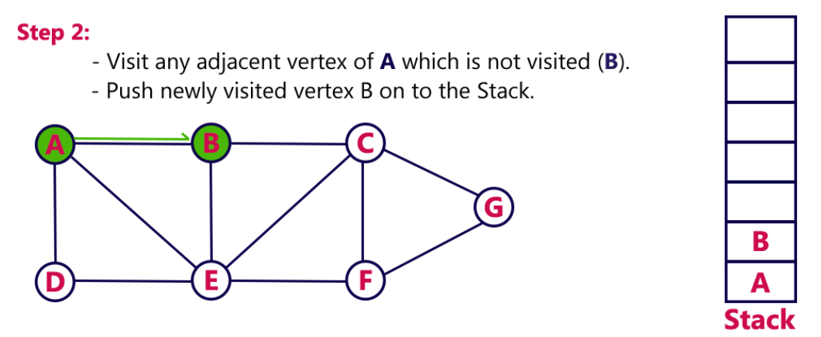

Slide 24
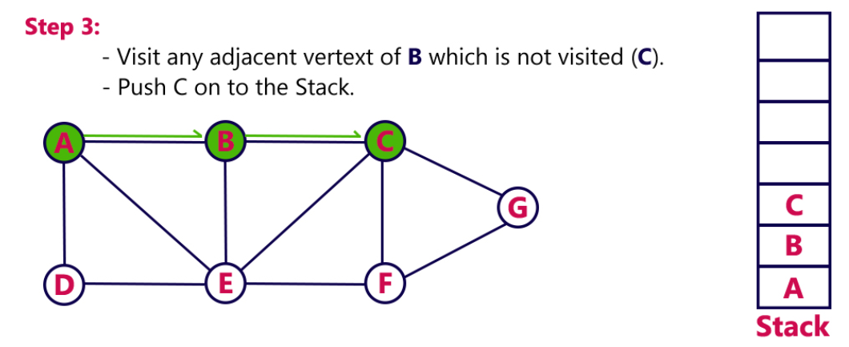

Slide 25
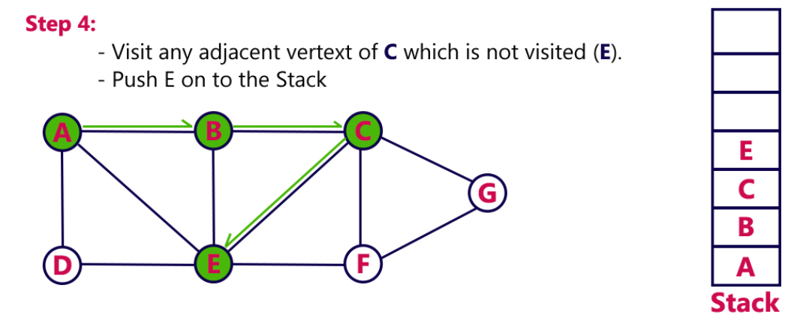

Slide 26
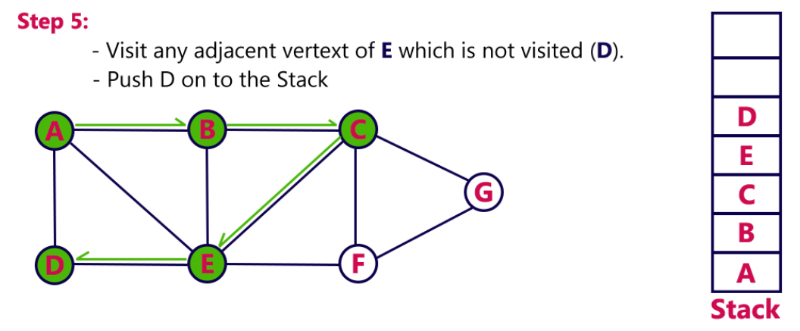

Slide 27
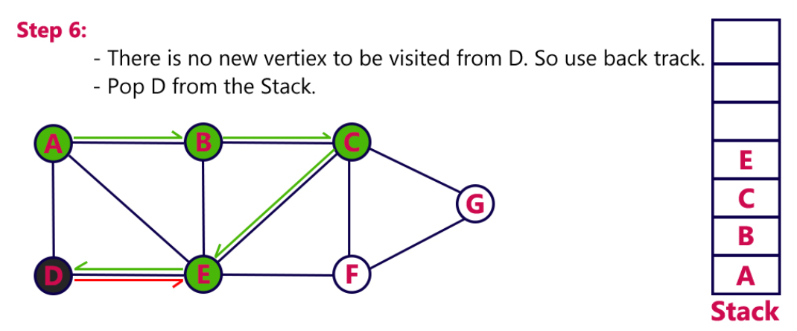

Slide 28
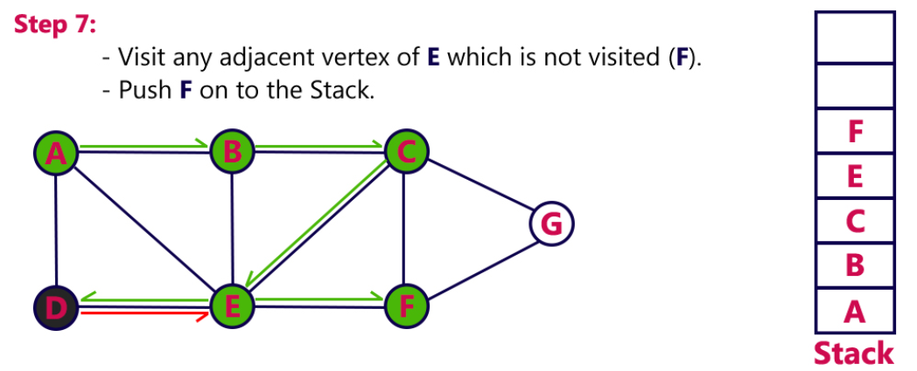

Slide 29
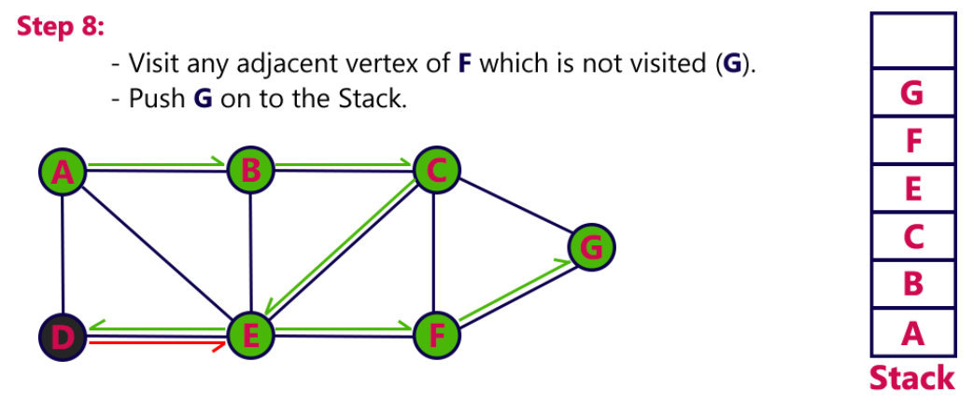

Slide 30
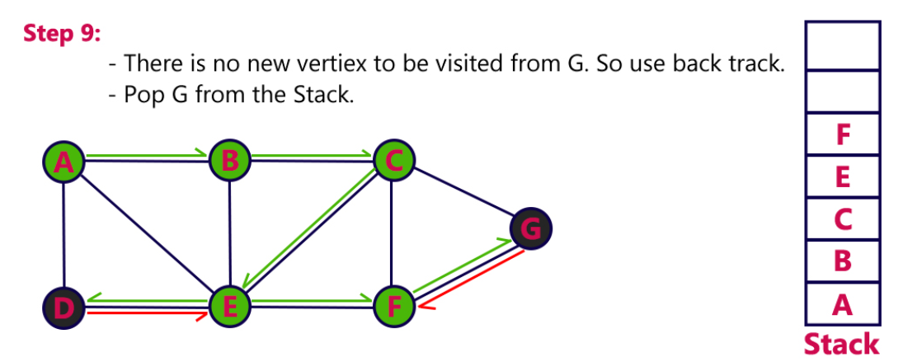

Slide 31
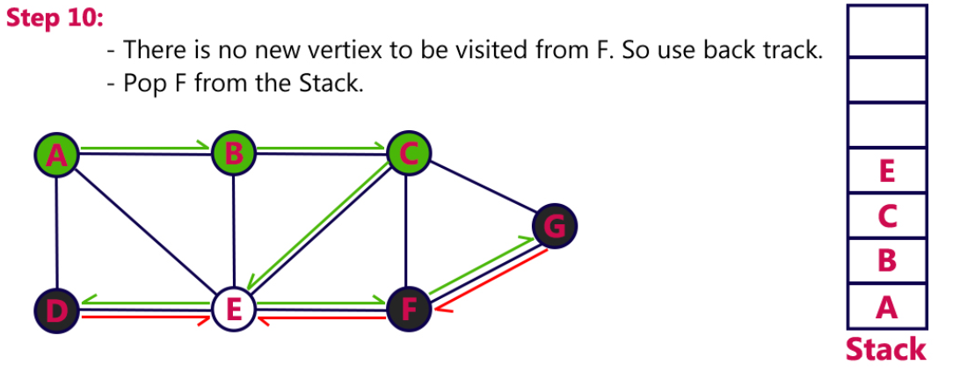

Slide 32
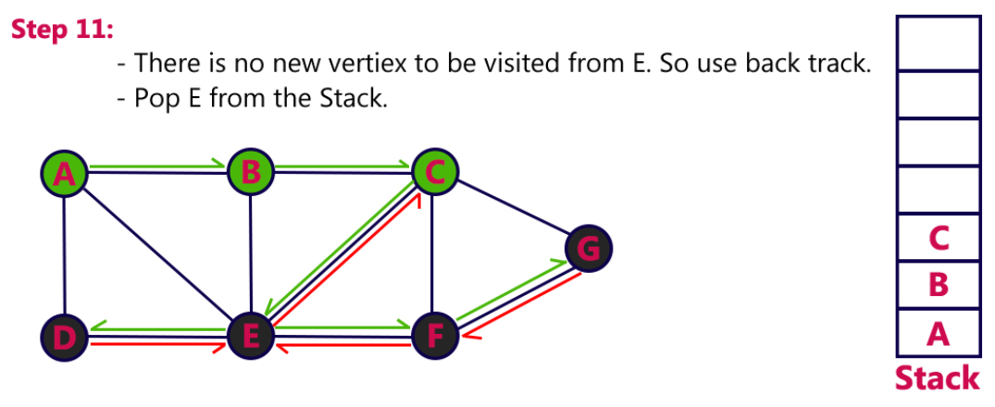

Slide 33
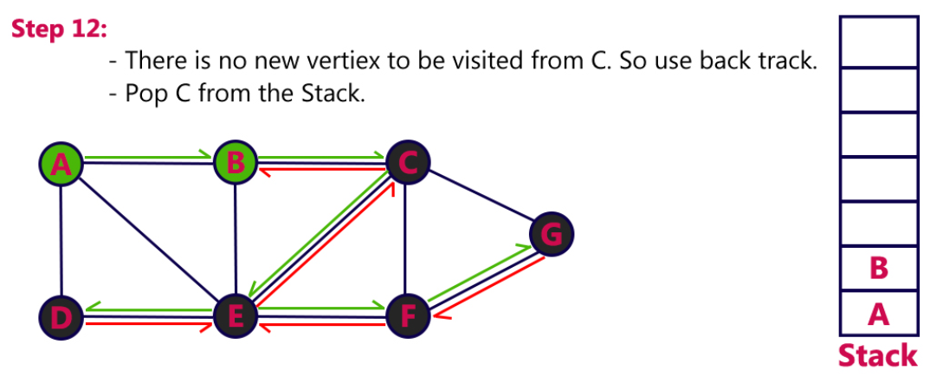

Slide 34
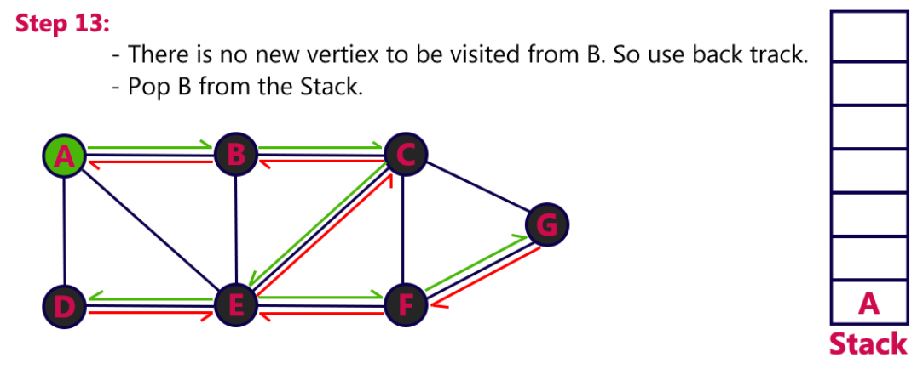

Slide 35
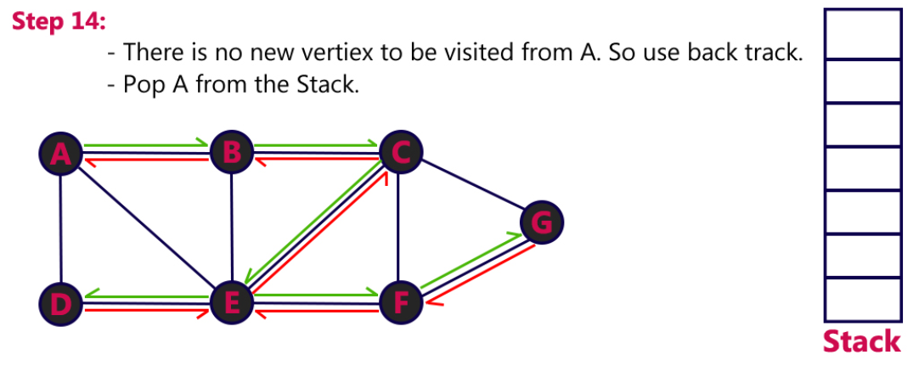

Slide 36
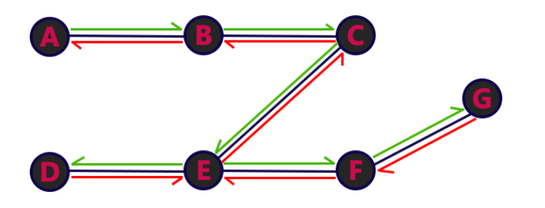
Final Result

Slide 37
Breadth First Search (BFS)
BFS traversal of a graph produces a spanning tree as final result.
Spanning Tree is a graph without loops.
We use Queue data structure with maximum size of total number of vertices in the graph to implement BFS traversal.

Slide 38
Steps
Step 1 - Define a Queue of size total number of vertices in the graph.
Step 2 - Select any vertex as starting point for traversal. Visit that vertex and insert it into the Queue.
Step 3 - Visit all the non-visited adjacent vertices of the vertex which is at front of the Queue and insert them into the Queue.
Step 4 - When there is no new vertex to be visited from the vertex which is at front of the Queue then delete that vertex.
Step 5 - Repeat steps 3 and 4 until queue becomes empty.
Step 6 - When queue becomes empty, then produce final spanning tree by removing unused edges from the graph

Slide 39
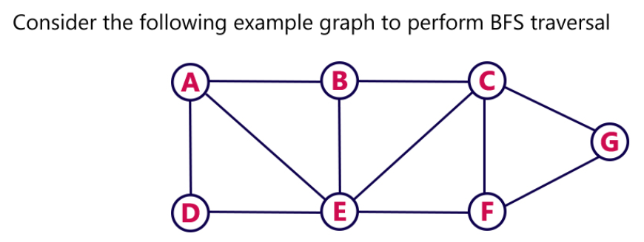
Example

Slide 40
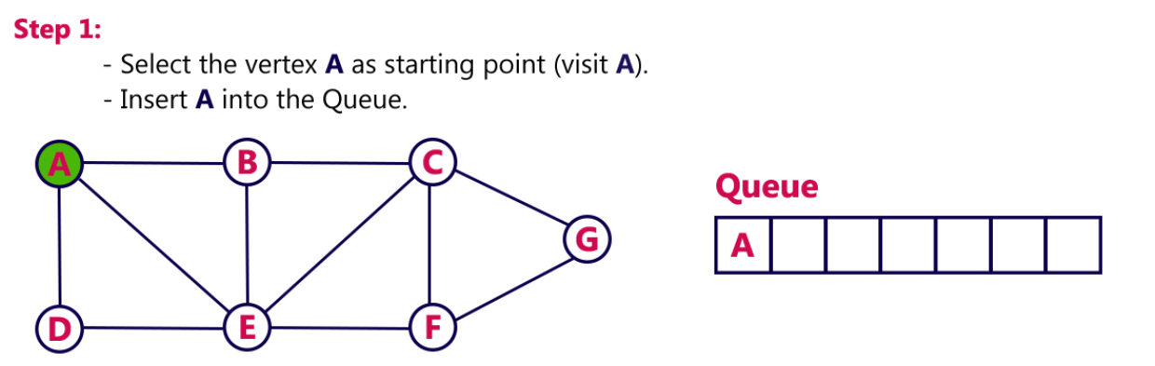

Slide 41
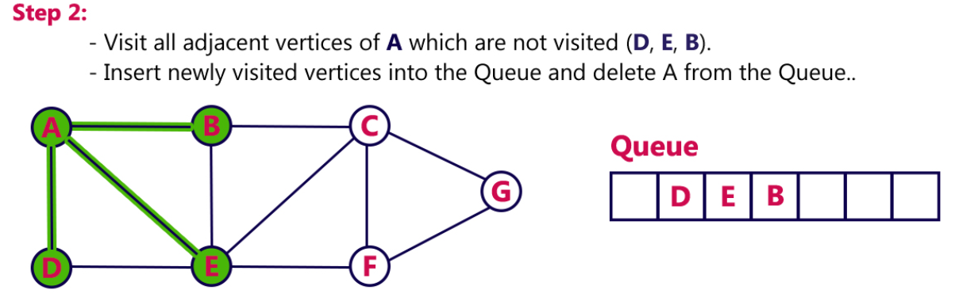

Slide 42
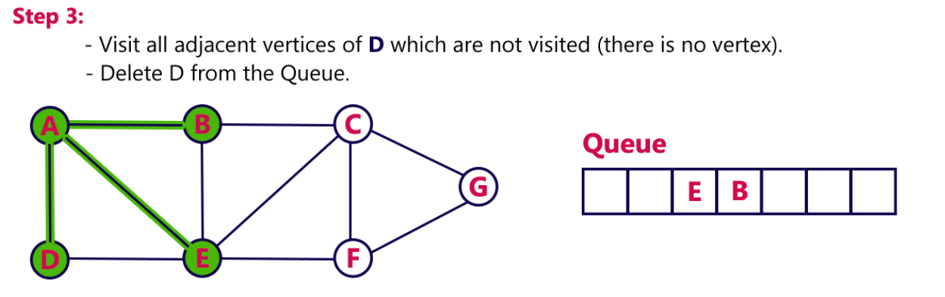

Slide 43
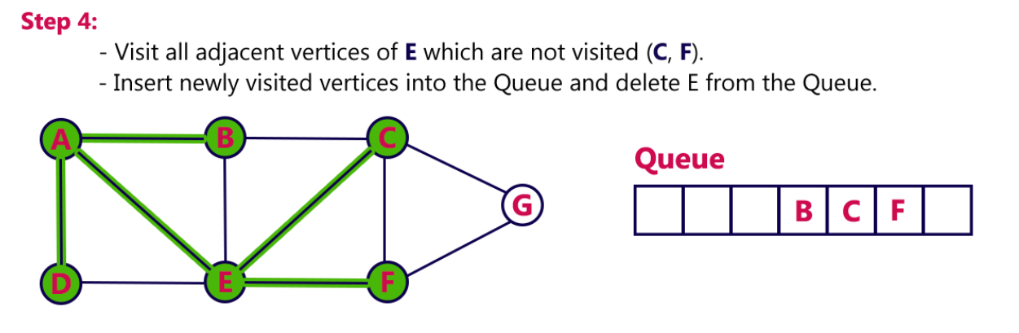

Slide 44
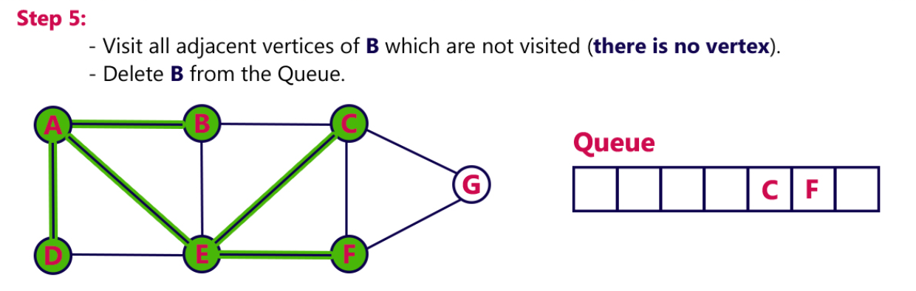

Slide 45
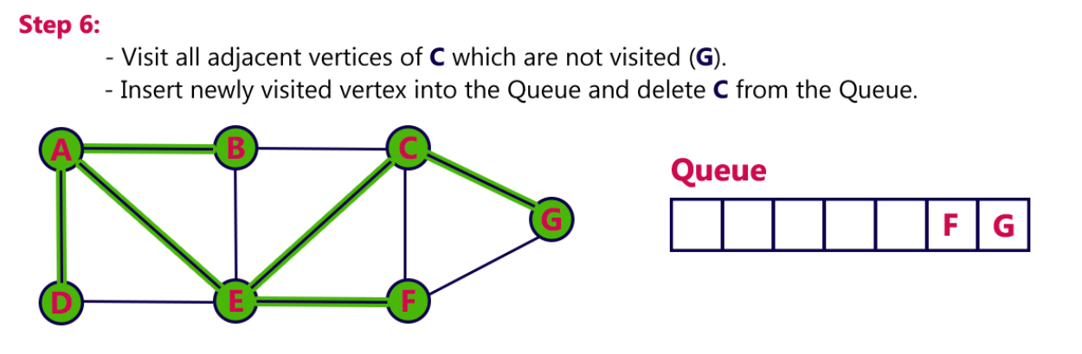

Slide 46
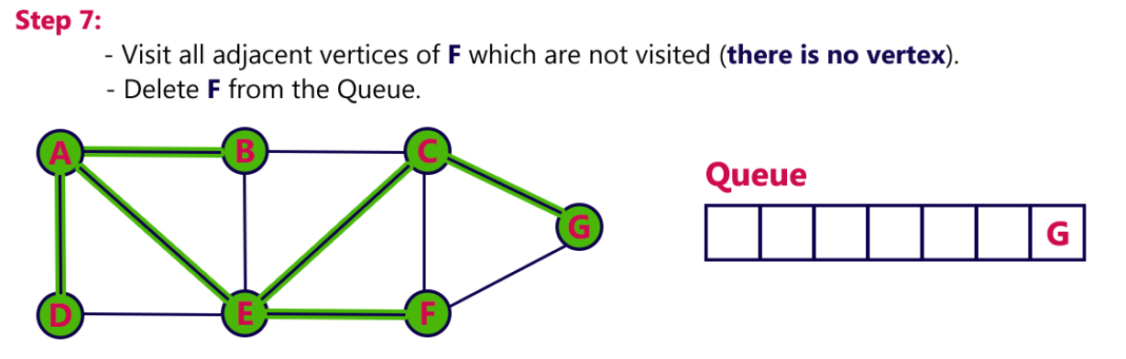

Slide 47
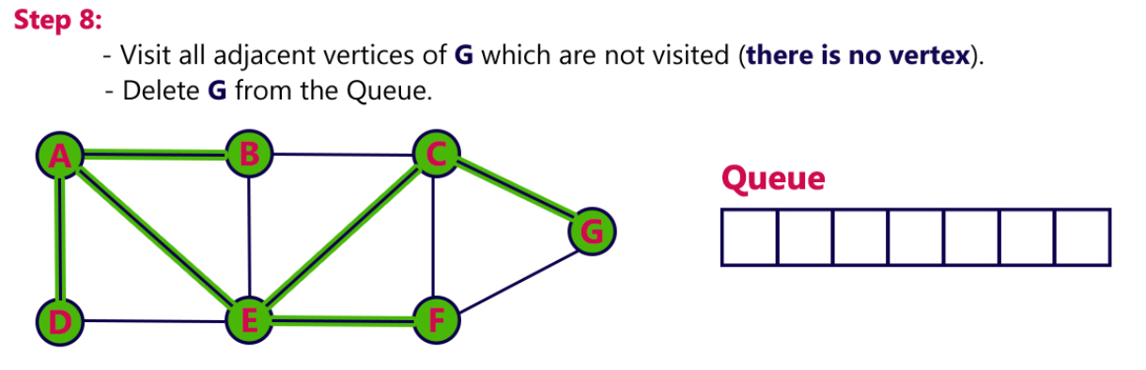

Slide 48
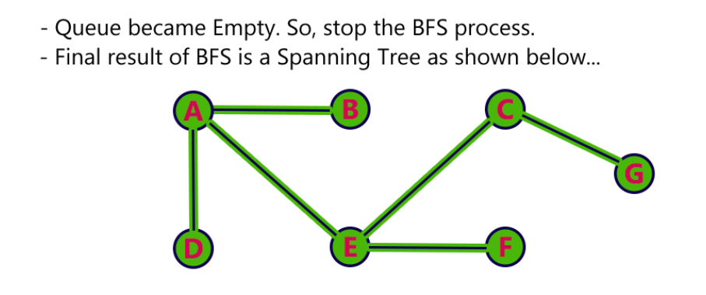

Slide 49
Graph
A graph can be defined as a group of vertices and edges to connect these vertices. The types of graphs are given as follows -
1. Undirected graph: An undirected graph is a graph in which all the edges do not point to any particular direction, i.e., they are not unidirectional; they are bidirectional. It can also be defined as a graph with a set of V vertices and a set of E edges, each edge connecting two different vertices.
2. Directed graph: Directed graphs are also known as digraphs. A graph is a directed graph (or digraph) if all the edges present between any vertices or nodes of the graph are directed or have a defined direction.
3. Connected graph: A connected graph is a graph in which a path always exists from a vertex to any other vertex. A graph is connected if we can reach any vertex from any other vertex by following edges in either direction.

Slide 50
Spanning Tree
A spanning tree can be defined as the subgraph of an undirected connected graph.
It includes all the vertices along with the least possible number of edges. If any vertex is missed, it is not a spanning tree.
A spanning tree is a subset of the graph that does not have cycles, and it also cannot be disconnected.

Slide 51
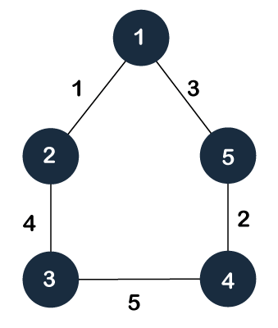
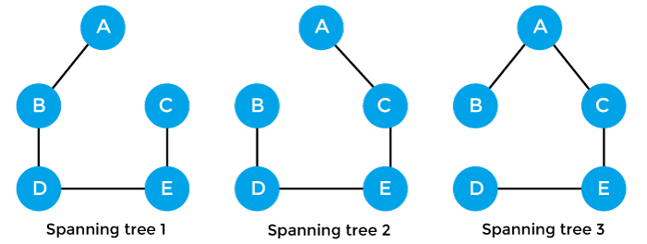
Example

Slide 52
Properties
There can be more than one spanning tree of a connected graph G.
A spanning tree does not have any cycles or loop.
A spanning tree is minimally connected, so removing one edge from the tree will make the graph disconnected.
A spanning tree is maximally acyclic, so adding one edge to the tree will create a loop.
There can be a maximum n^{n-2} number of spanning trees that can be created from a complete graph.
A spanning tree has n-1 edges, where 'n' is the number of nodes.
If the graph is a complete graph, then the spanning tree can be constructed by removing maximum (e-n+1) edges, where 'e' is the number of edges and 'n' is the number of vertices.

Slide 53
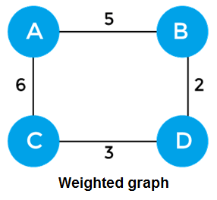
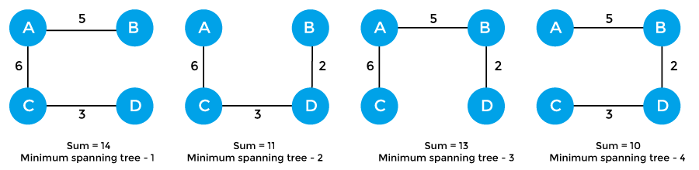
Minimum Spanning Tree

Slide 54
Applications
Minimum spanning tree can be used to design water-supply networks, telecommunication networks, and electrical grids.
It can be used to find paths in the map.

Slide 55
Prim’s Algorithm
Prim's Algorithm is a greedy algorithm that is used to find the minimum spanning tree from a graph.
Prim's algorithm finds the subset of edges that includes every vertex of the graph such that the sum of the weights of the edges can be minimized.

Slide 56
Steps
First, we have to initialize an MST with the randomly chosen vertex.
Now, we have to find all the edges that connect the tree in the above step with the new vertices. From the edges found, select the minimum edge and add it to the tree.
Repeat step 2 until the minimum spanning tree is formed.

Slide 57
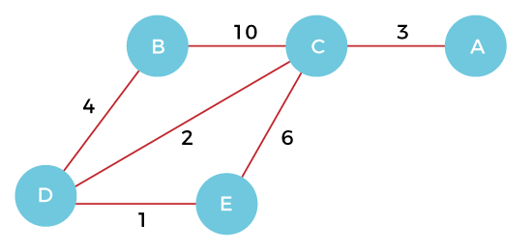
Example

Slide 58
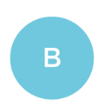
Step 1

Slide 59
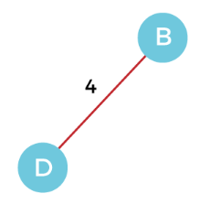
Step 2

Slide 60
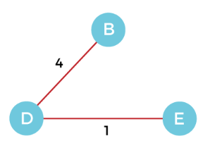
Step 3

Slide 61
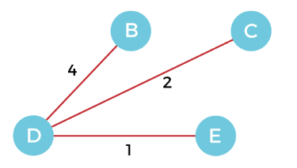
Step 4

Slide 62
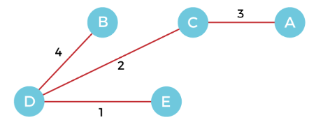
Step 5

Slide 63
Cost
Cost of MST = 4 + 2 + 1 + 3 = 10 units.

Slide 64
Algorithm
Step 1: Select a starting vertex
Step 2: Repeat Steps 3 and 4 until there are fringe vertices
Step 3: Select an edge 'e' connecting the tree vertex and fringe vertex that has minimum weight
Step 4: Add the selected edge and the vertex to the minimum spanning tree T
[END OF LOOP]
Step 5: EXIT

Slide 65
Kruskal’s Algorithm
Kruskal's Algorithm is used to find the minimum spanning tree for a connected weighted graph.
The main target of the algorithm is to find the subset of edges by using which we can traverse every vertex of the graph.
It follows the greedy approach that finds an optimum solution at every stage instead of focusing on a global optimum.

Slide 66
Steps
First, sort all the edges from low weight to high.
Now, take the edge with the lowest weight and add it to the spanning tree. If the edge to be added creates a cycle, then reject the edge.
Continue to add the edges until we reach all vertices, and a minimum spanning tree is created.

Slide 67
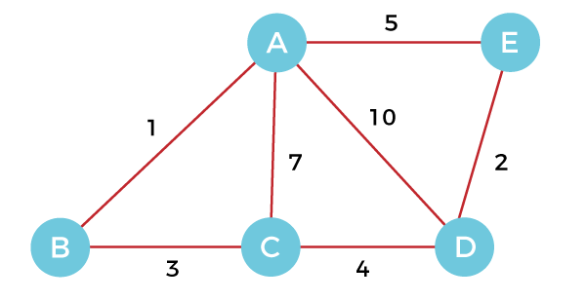
Example

Slide 68
Step 1

Slide 69
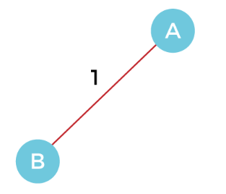
Step 2

Slide 70
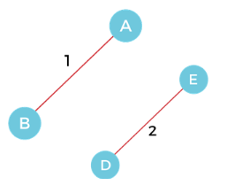
Step 3

Slide 71
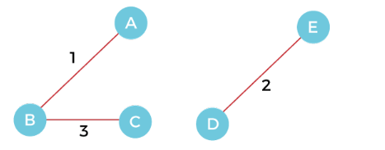
Step 4

Slide 72
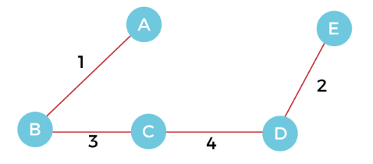
Step 5

Slide 73
Further
Step 6 - After that, pick the edge AE with weight 5. Including this edge will create the cycle, so discard it.
Step 7 - Pick the edge AC with weight 7. Including this edge will create the cycle, so discard it.
Step 8 - Pick the edge AD with weight 10. Including this edge will also create the cycle, so discard it.

Slide 74
Cost
The cost of the MST is = AB + DE + BC + CD = 1 + 2 + 3 + 4 = 10.

Slide 75
Algorithm
Step 1: Create a forest F in such a way that every vertex of the graph is a separate tree.
Step 2: Create a set E that contains all the edges of the graph.
Step 3: Repeat Steps 4 and 5 while E is NOT EMPTY and F is not spanning
Step 4: Remove an edge from E with minimum weight
Step 5: IF the edge obtained in Step 4 connects two different trees, then add it to the forest F
(for combining two trees into one tree).
ELSE
Discard the edge
Step 6: END

Slide 76
Dijkstra’s Algorithm
Dijkstra's algorithm allows us to find the shortest path between any two vertices of a graph.
It differs from the minimum spanning tree because the shortest distance between two vertices might not include all the vertices of the graph.

Slide 77
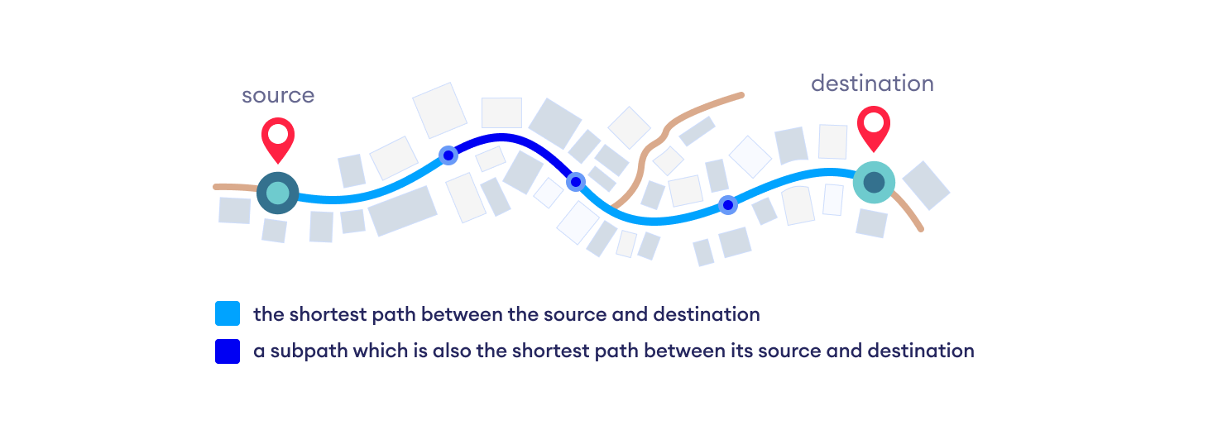
Central Idea
Dijkstra's Algorithm works on the basis that any subpath B -> D of the shortest path A -> D between vertices A and D is also the shortest path between vertices B and D.

Slide 78
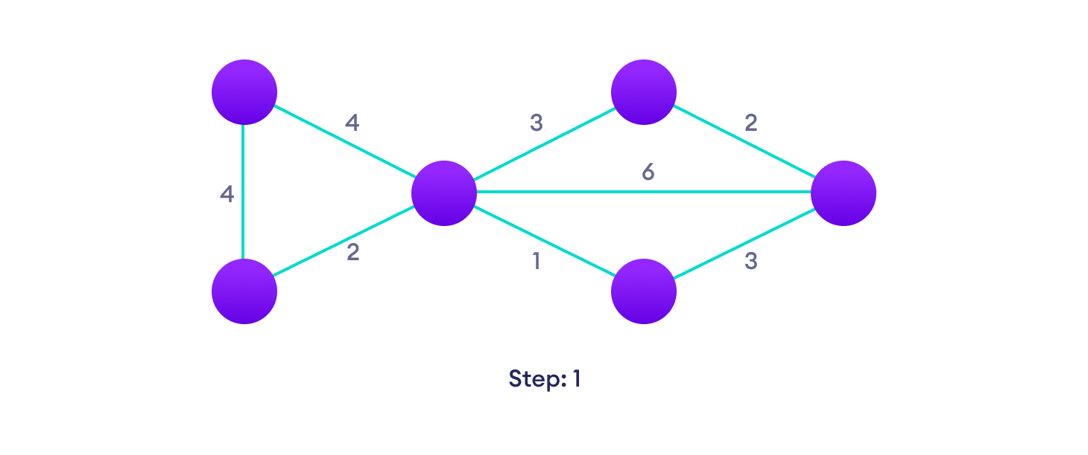
Example

Slide 79
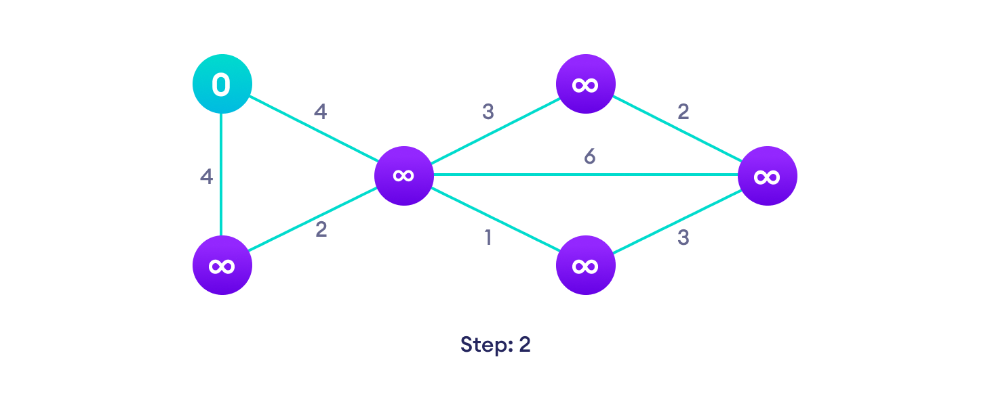

Slide 80
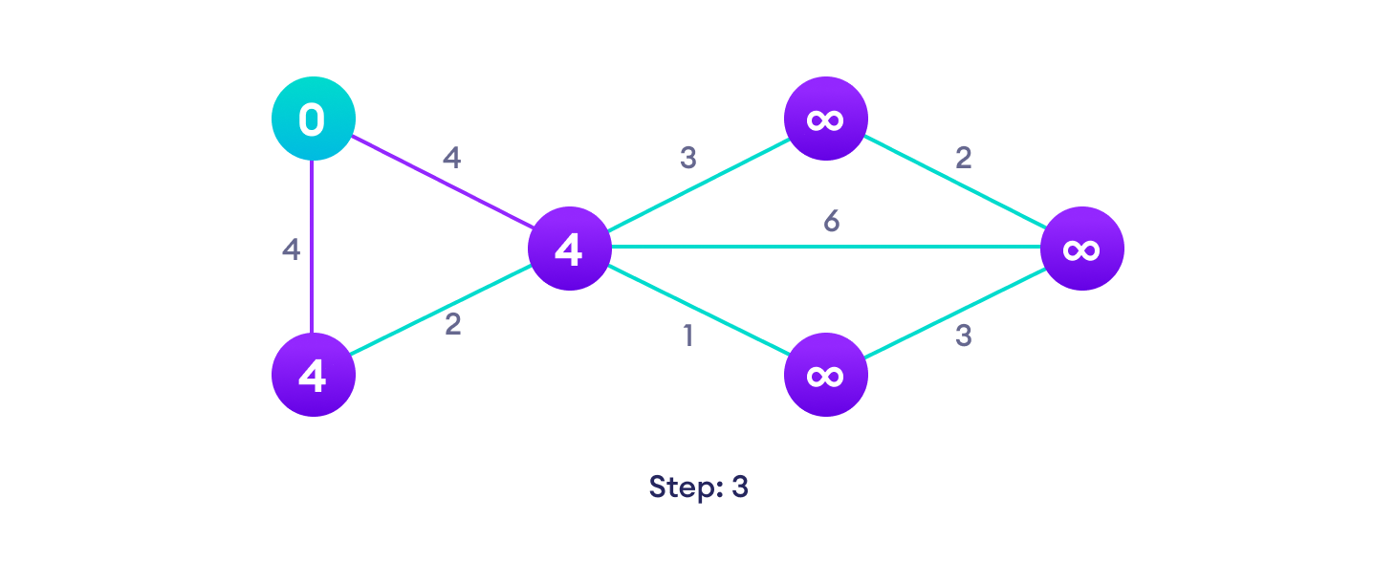

Slide 81
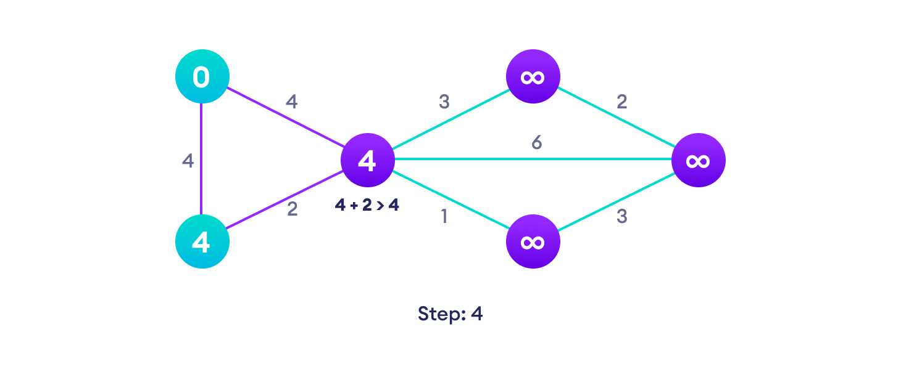

Slide 82


Slide 83


Slide 84


Slide 85


